Slide 1

Capstone Project of Google Data Analyst Certificate -Case study: How does a bike-share navigate speedy success?
Dongyuan Gao
22.08.2024

Slide 2
Analyze, key tasks
How should you organize your data to perform analysis on it?
--I should categorize trips with different groups so that I could makes some observations.
● Has your data been properly formated?
--yes, we made sure the format are consistent.
What surprises did you discover in the data?
--We found out that casual users ride much more on weekends,
and members on weekdays, which makes sense, but was surprising and no obvious before analyzing.
What trends or relationships did you find in the data?-
--From a behaviour point of view, casual riders ride longer, and prefer weekends.
Member riders ride more on weekdays, and probably use the bikes for commute.
Both groups prefer riding after 12 pm.
How will these insights help answer your business questions?
--These insights show some clear behaviour diffrences. Maybe we could find some good practices to convert more casual riders to member riders.
And we can also target those users better according to their preferences.

Slide 3

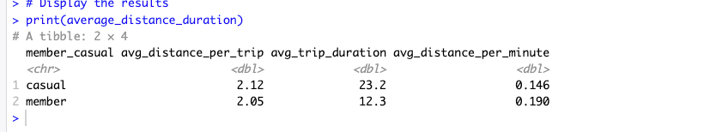
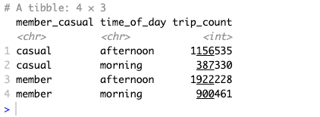
Summary of the analysis
In total, in the cleaned data set, there are 1543865 casual rider trips, and 2822689 trips of member riders.
Casual riders ride longer time and distances:
Both groups ride more after 12p.m. Probably it is because more people don't want to start physical activities in the morning.

Slide 4
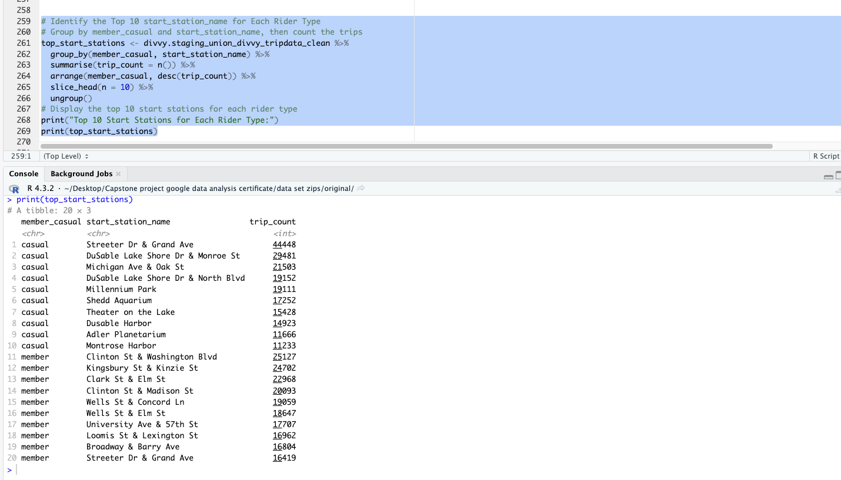
Summary of the analysis
There is a greater concentration on several stations for both groups(start station):

Slide 5
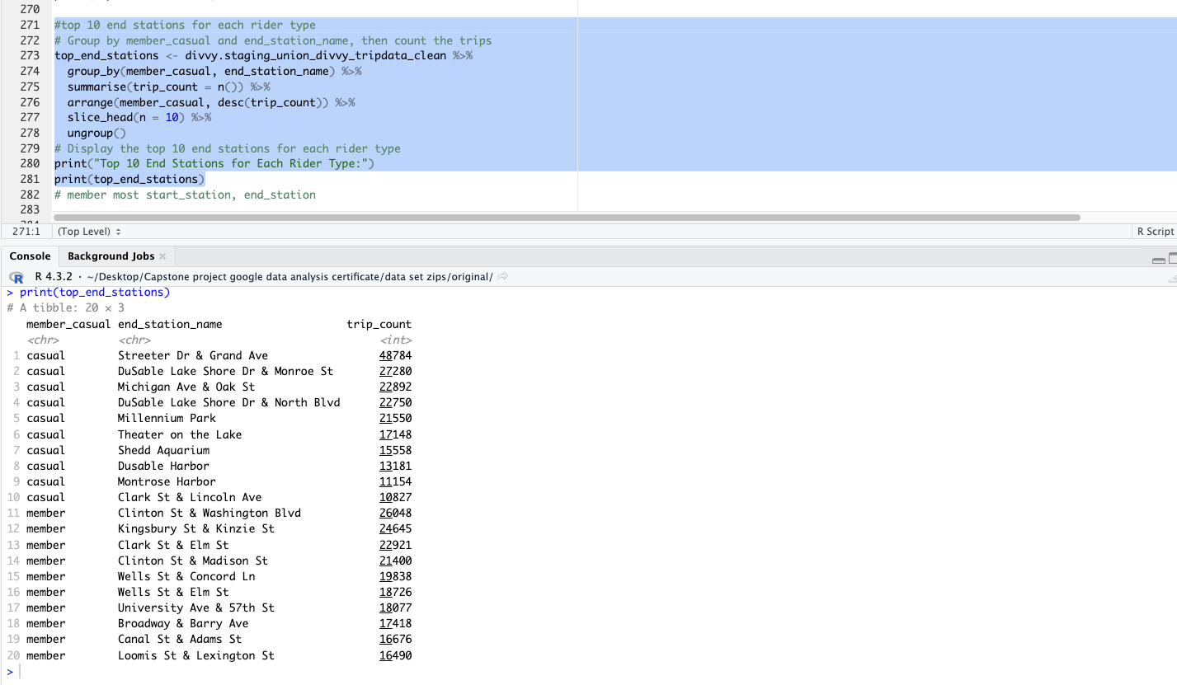
Summary of the analysis
There is a greater concentration on several stations for both groups(end station):

Slide 6
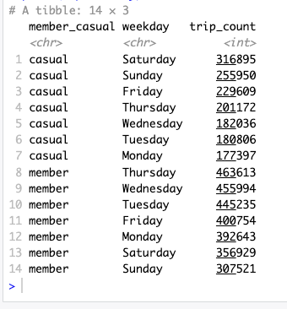
Summary of the analysis
Casual riders ride much more on the weekend and members on the weekdays.
It might mean that casual riders are using the service more for weekend trips and the members using it for the daily commute to work.

Slide 7
Top 3 recommendations
Make a membership plan that suits the casual users, for example, for weekends, and it might be slightly cheaper than normal membership. So that we can convert more casual users to members.
Promote the offer around very densely used areas and stations. For example, Streeter Dr. Grand Ave.
The focus of the promotion should be centered around weekend trip, city tour and leisure ridings in the summer. Detailed areas and stations can be found in interative map file: map.html.

Slide 8
Visualization 1

